Slide 1

Sound/Spelling Cards

Slide 2
We will begin by reviewing the short vowels and consonants:

Slide 3


Slide 4
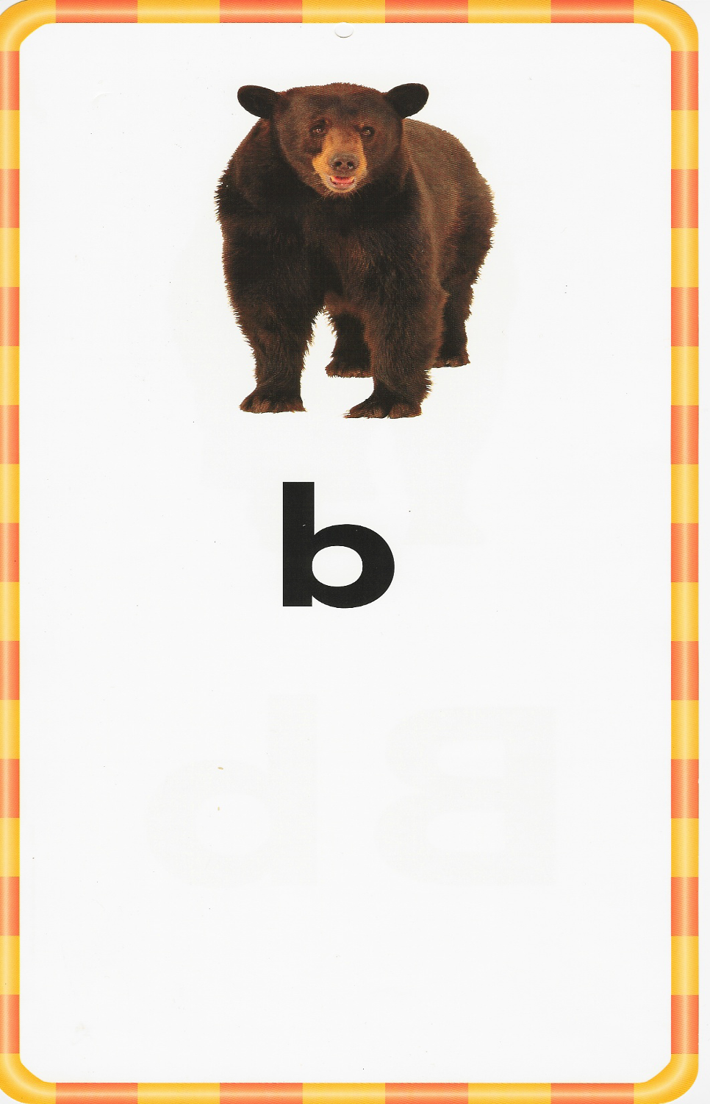

Slide 5
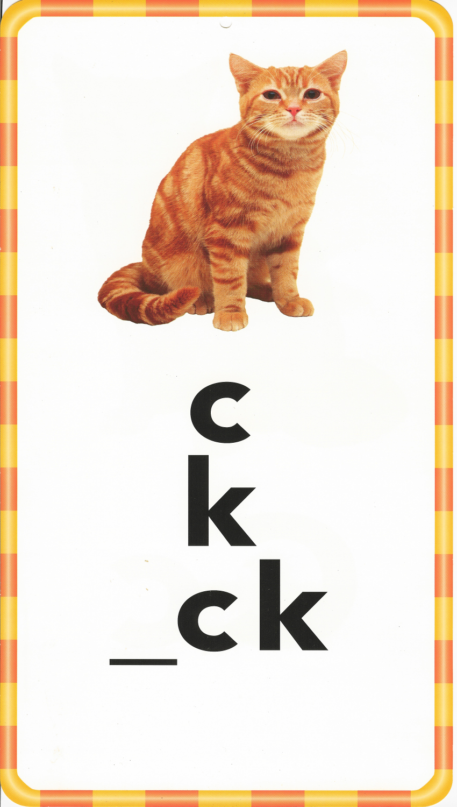

Slide 6
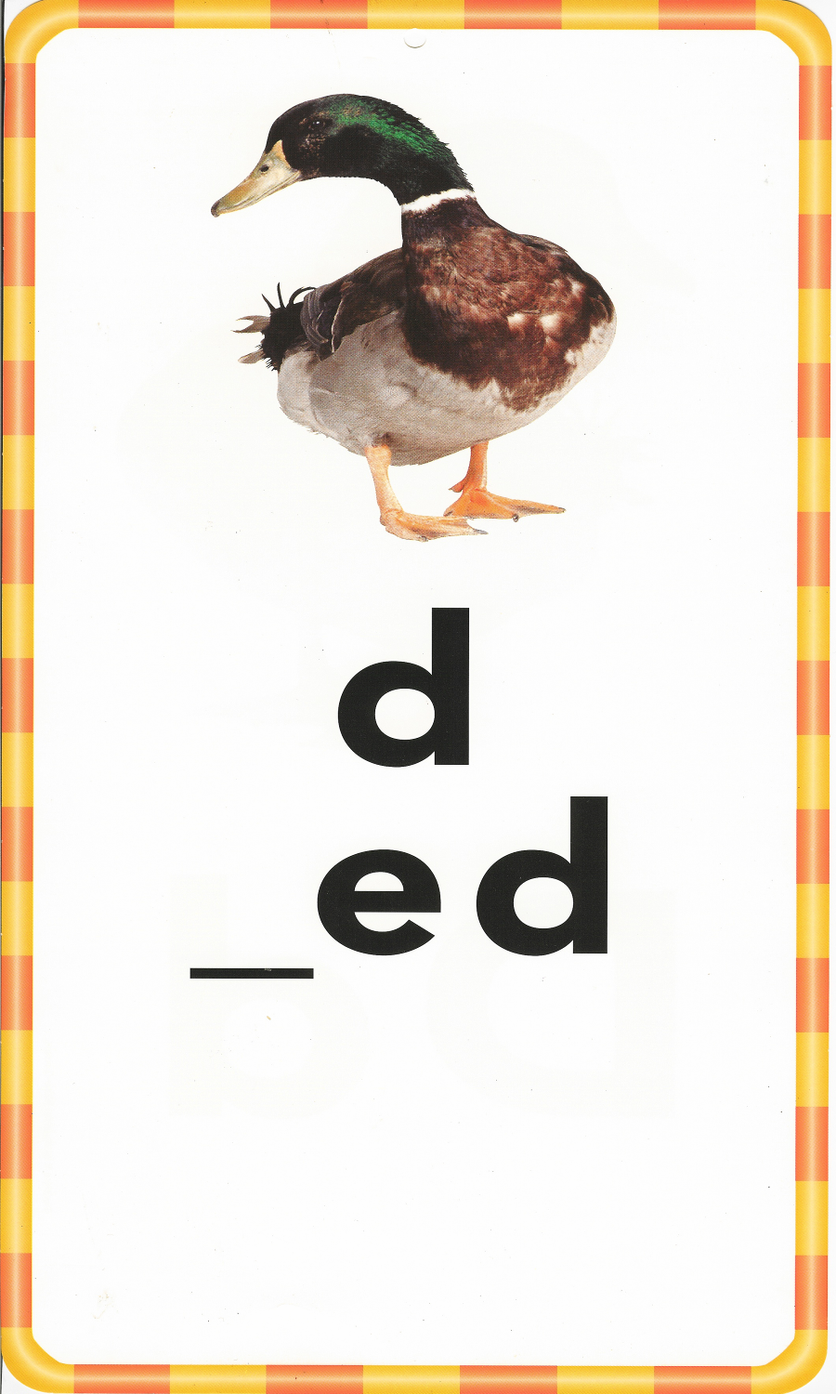
Base Word

Slide 7
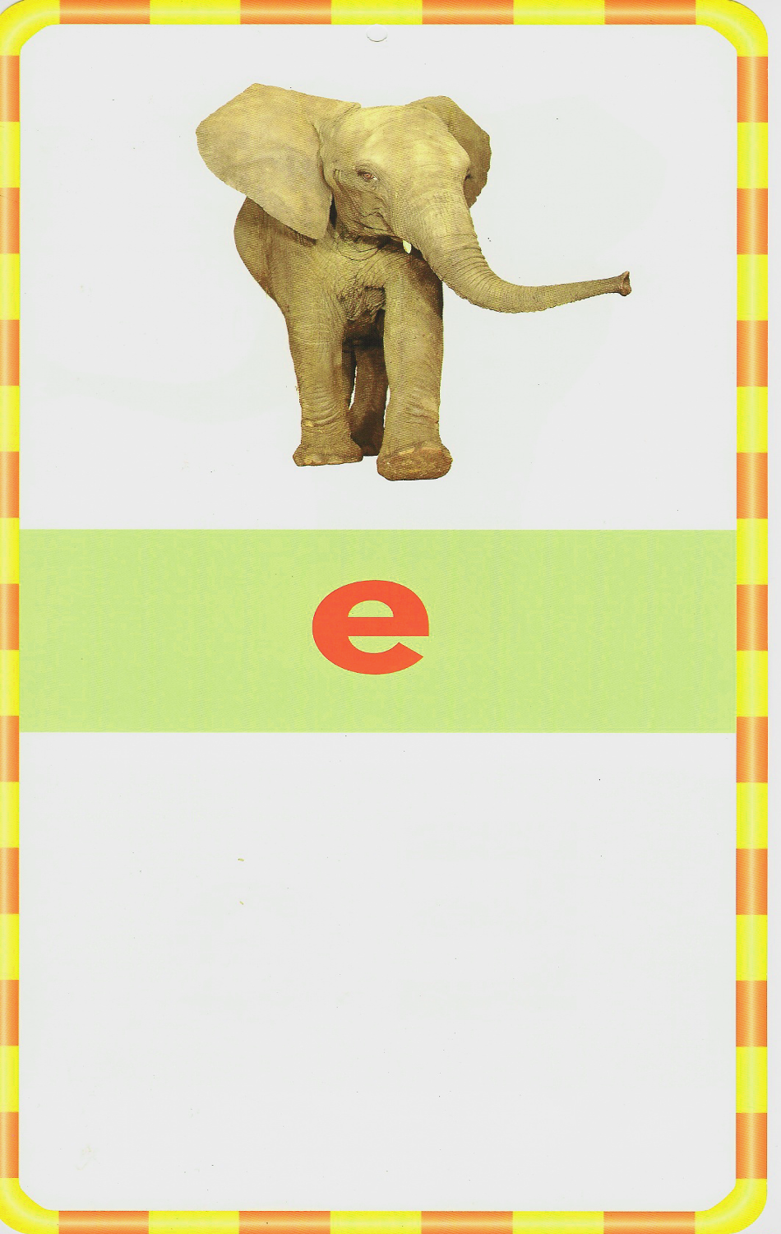

Slide 8


Slide 9
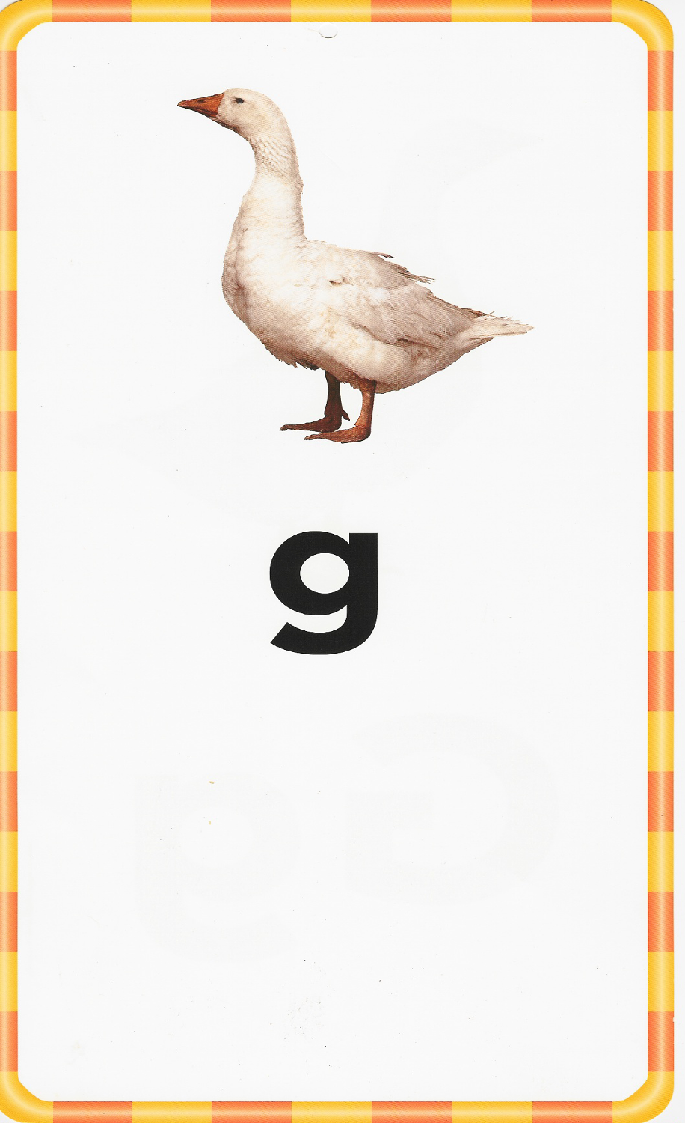

Slide 10
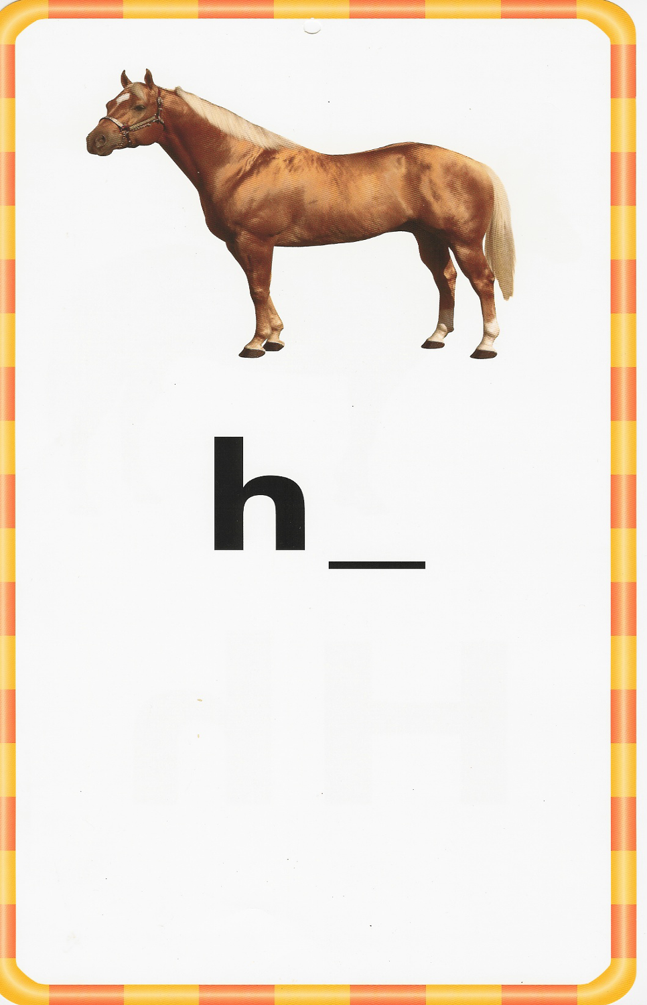
Vowel

Slide 11


Slide 12


Slide 13


Slide 14

Consonant

Slide 15


Slide 16
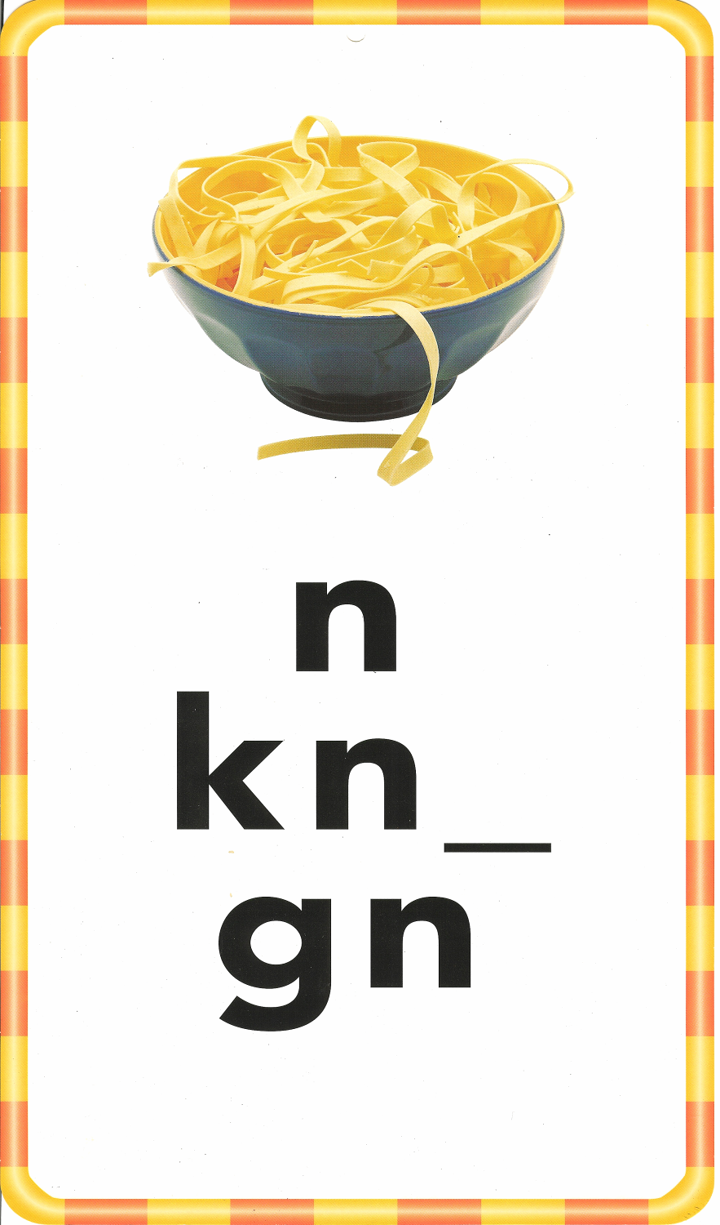
Vowel

Slide 17
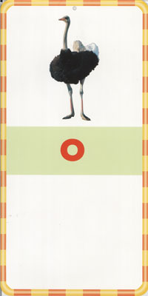

Slide 18
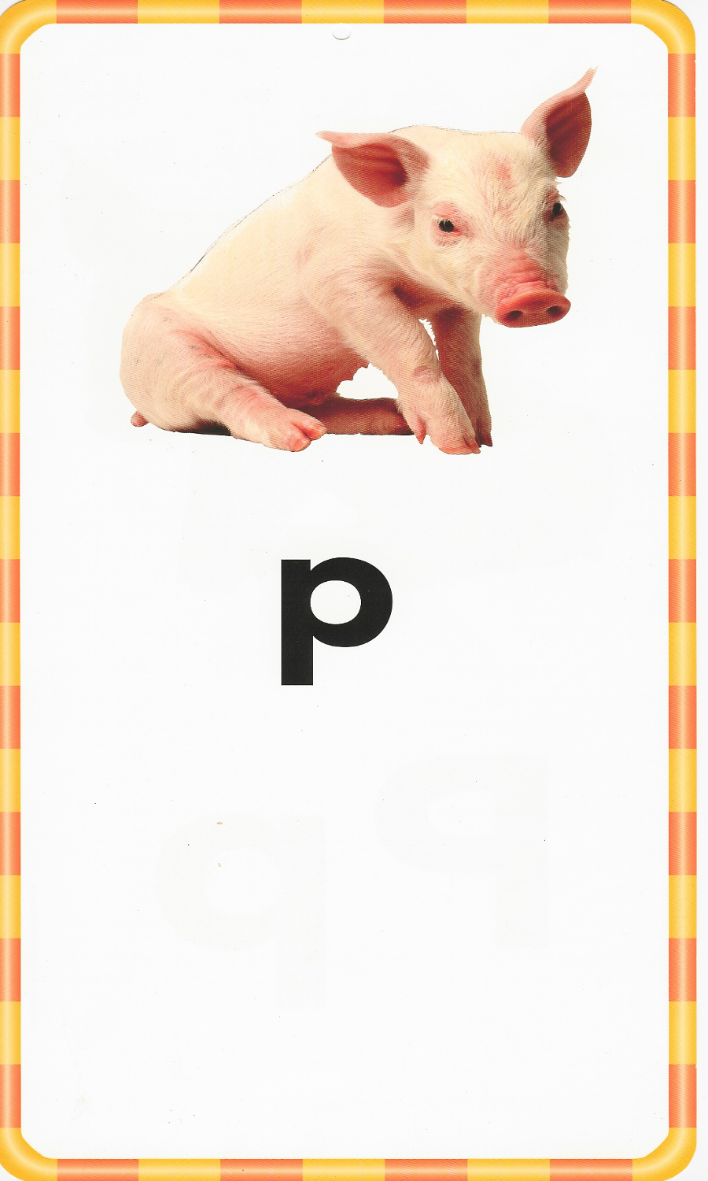

Slide 19
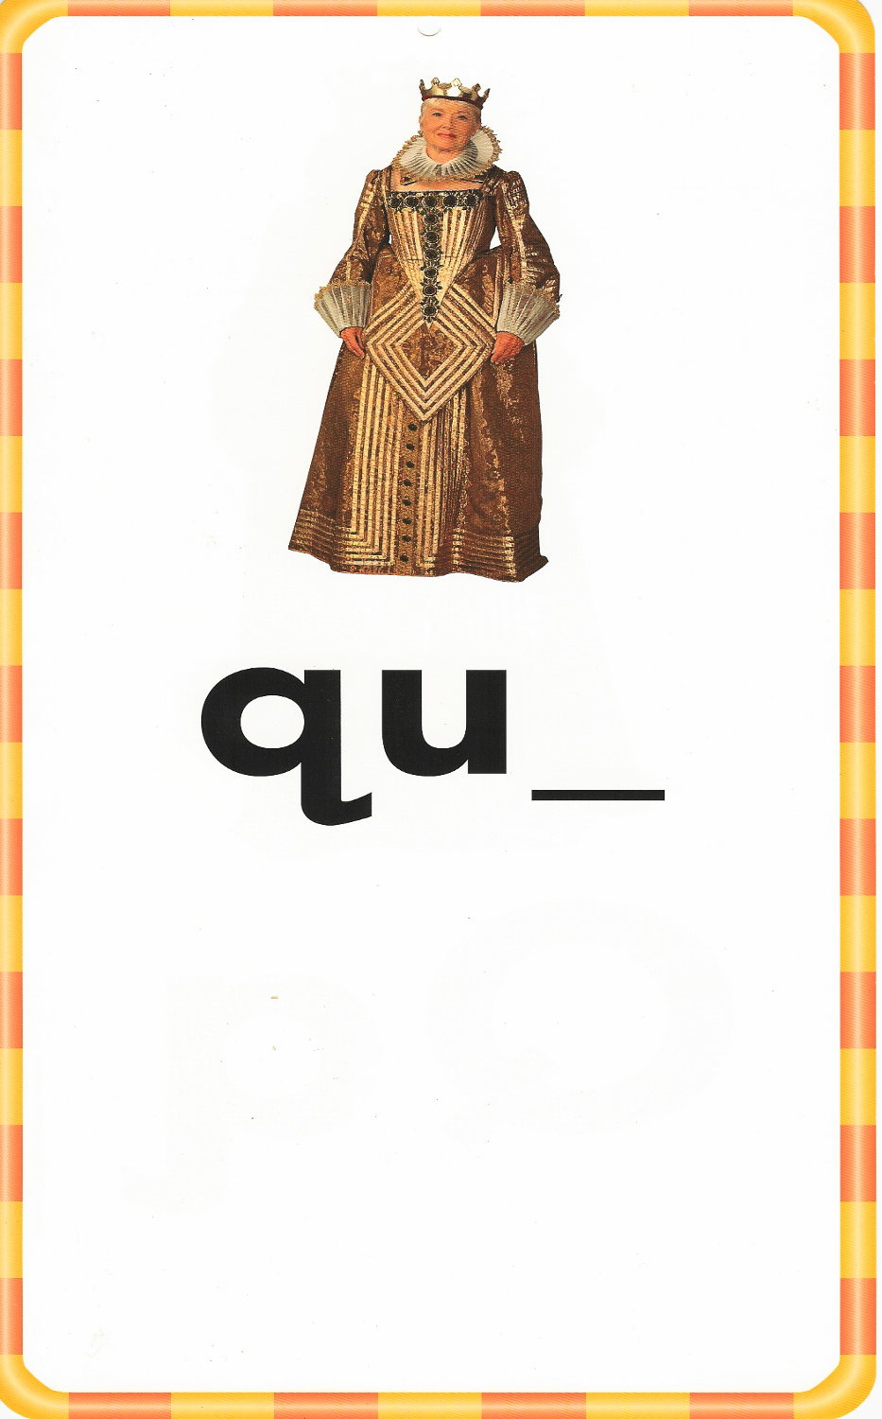
Vowel

Slide 20
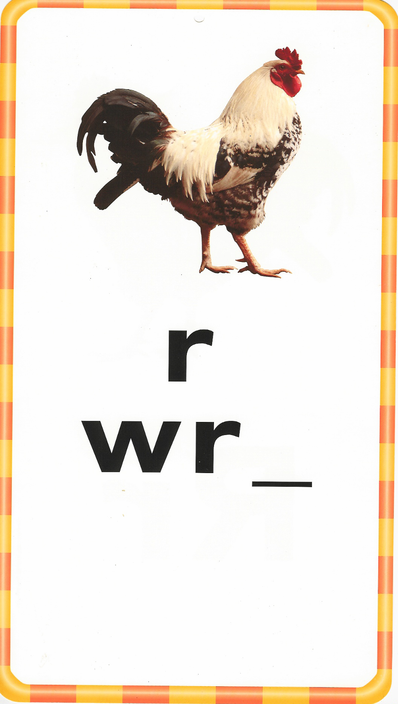
Vowel

Slide 21


Slide 22

Base Word

Slide 23


Slide 24


Slide 25
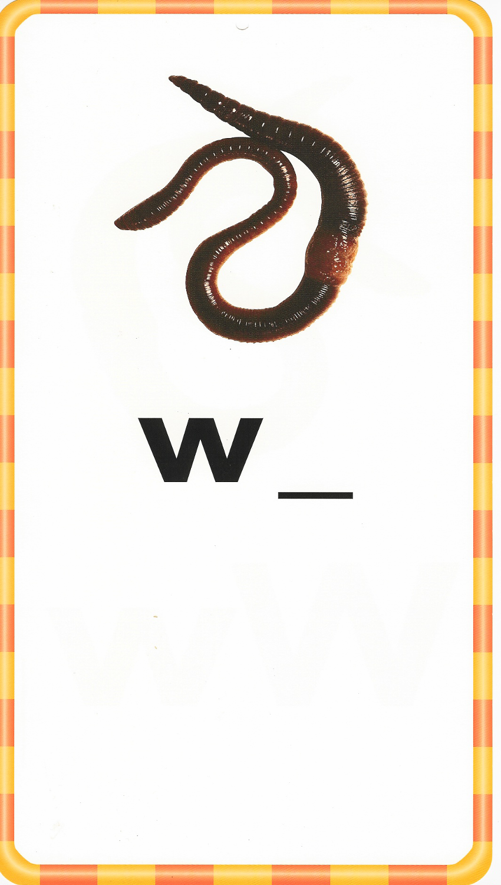
Vowel

Slide 26
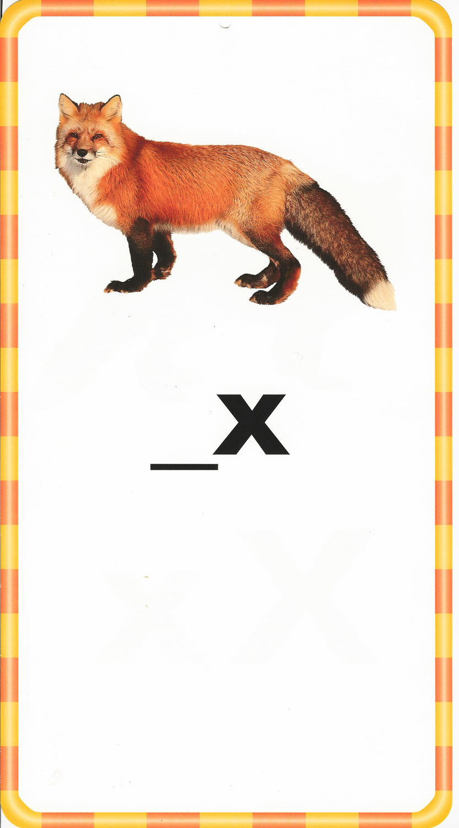

Slide 27
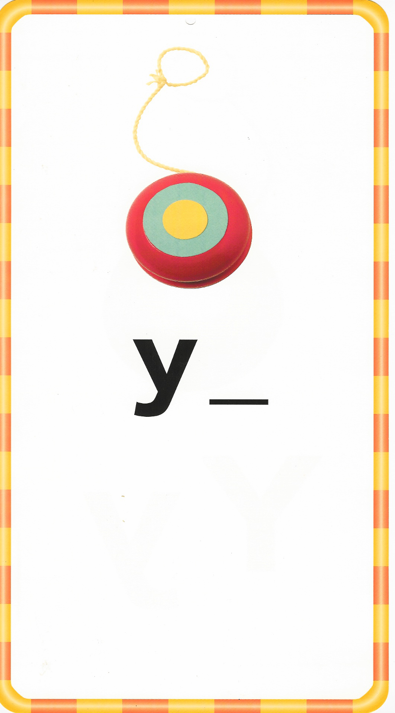
Vowel

Slide 28
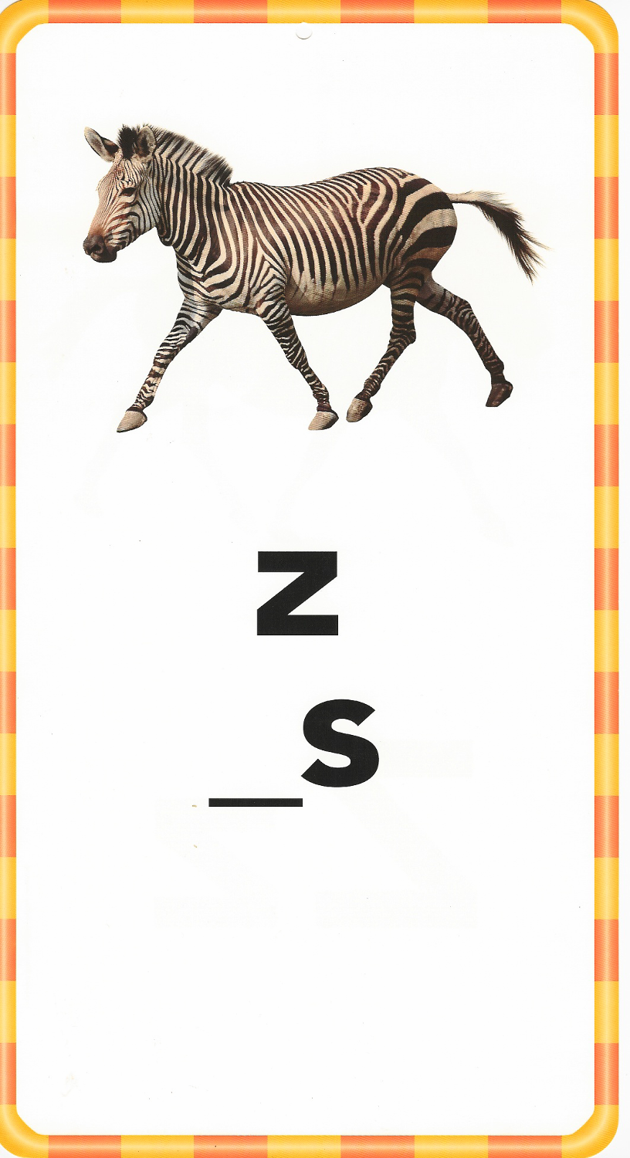

Slide 29
Now we will review the consonant digraphs:

Slide 30
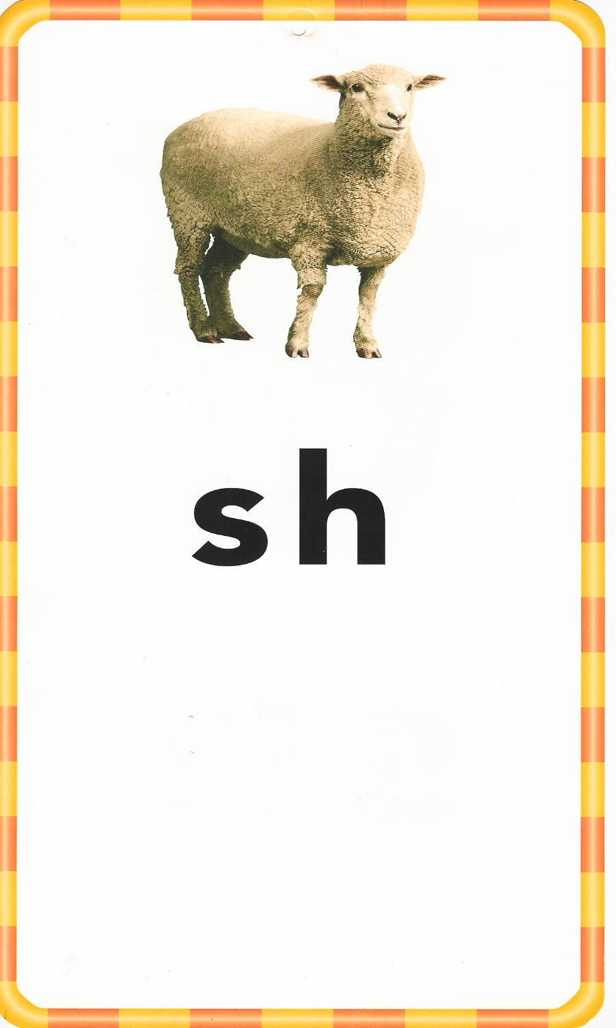

Slide 31


Slide 32

Vowel

Slide 33


Slide 34
Now we will review the long vowels:

Slide 35
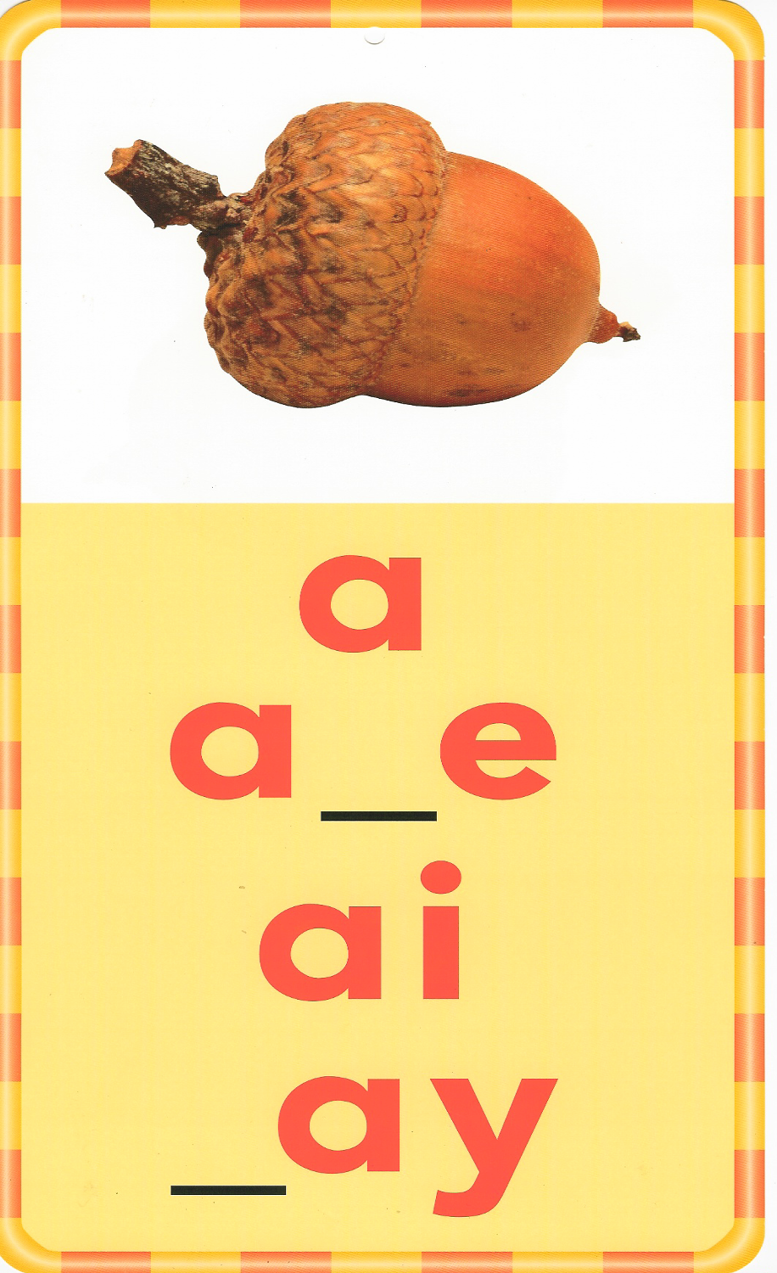
Consonant
Consonant

Slide 36

Consonant

Slide 37

Consonant
Consonant

Slide 38
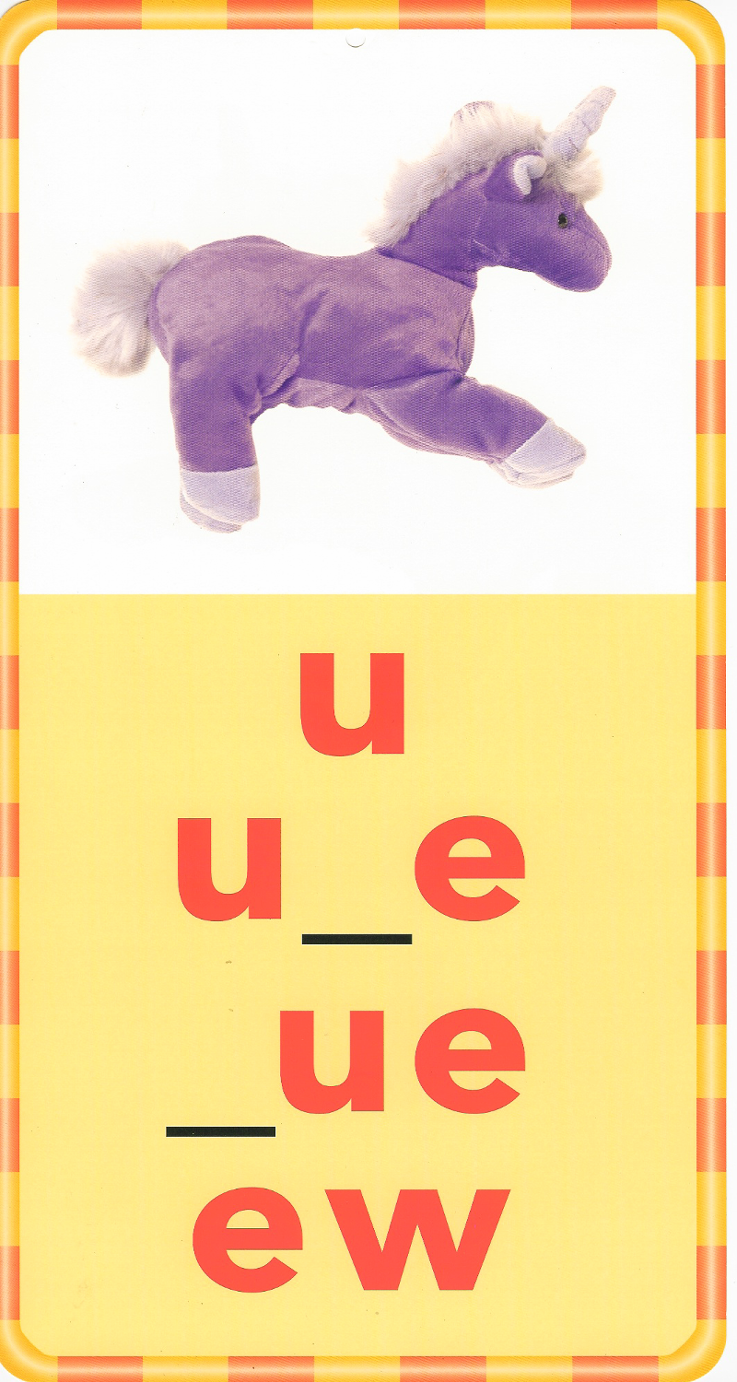
Consonant
Consonant

Slide 39
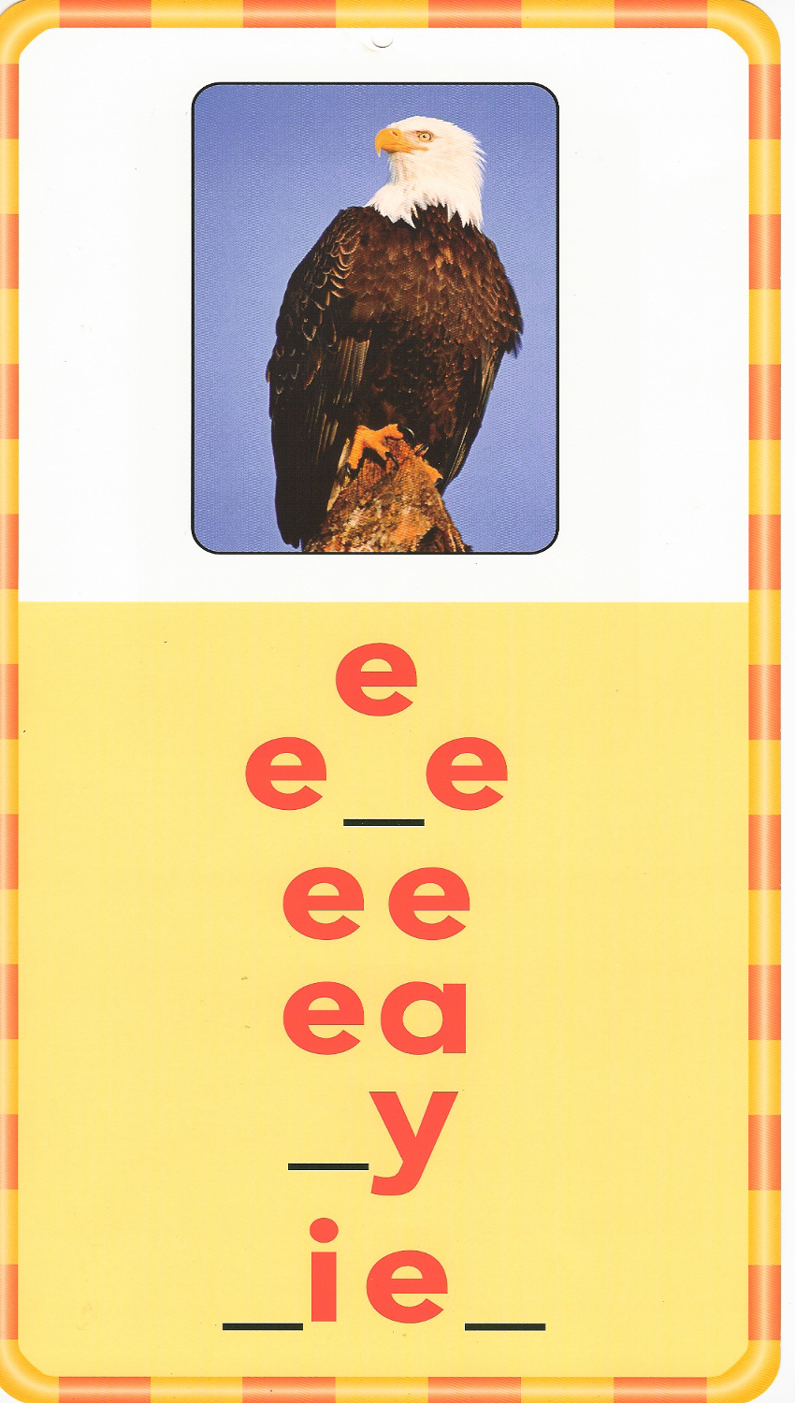
Consonant
Consonant
Consonant

Slide 40
Now we will review the vowel pairs:

Slide 41


Slide 42

Consonant
Consonant

Slide 43


Slide 44

Consonant

Slide 45


Slide 46


Slide 47


Slide 48
