Slide 1
Latin Root Words
Created by Grace Seymour, 2011
Modified by C. Jauregui, 2015

Slide 2
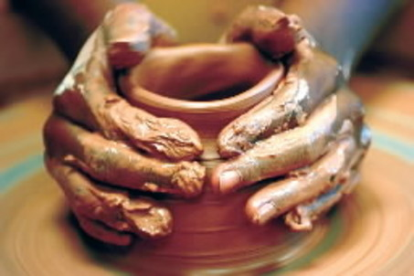
To Shape
Formula
Inform
Perform
Uniform
Transform

Slide 3
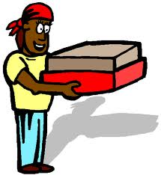
To Carry
Airport
Export
Portable
Transport

Slide 4
To Break or Burst
Disrupt
Eruption
Interrupt

Slide 5
To Write
Describe
Indescribable
Prescribe
Scribble
Scripture
Subscription

Slide 6
To see, watch, or observe
Aspect
Inspect
Perspective
Suspect
Suspicious
Suspicion

Slide 7
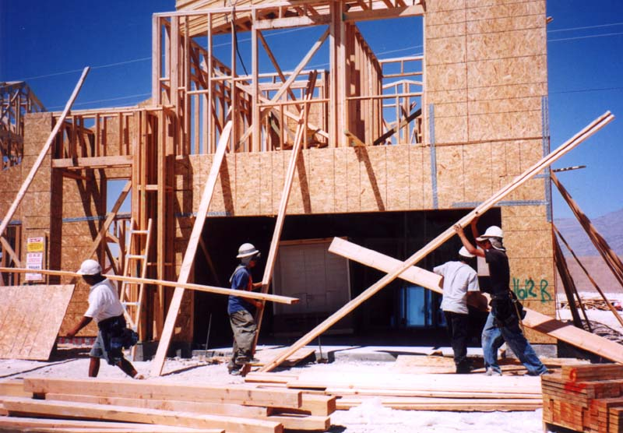
To Build/Assemble
Construct
Destruction
Instruct
Structure

Slide 8
To Bend Or Curve
Flexible
Flexibility
Reflex
Reflect
Reflection

Slide 9
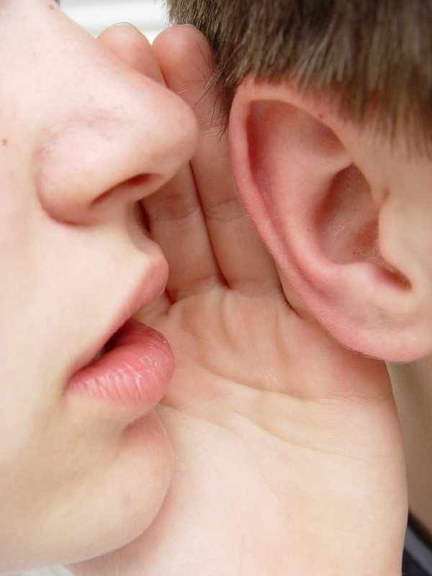
To Say Or Tell
Dictionary
Ridiculous
Addiction
Dictator
Prediction

Slide 10
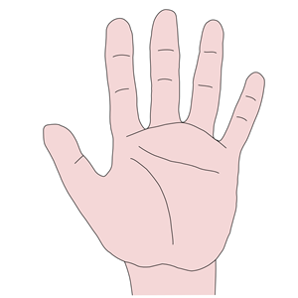
Hand
Manage
Manual
Manufacture
Manicure

